Slide 1


Slide 2
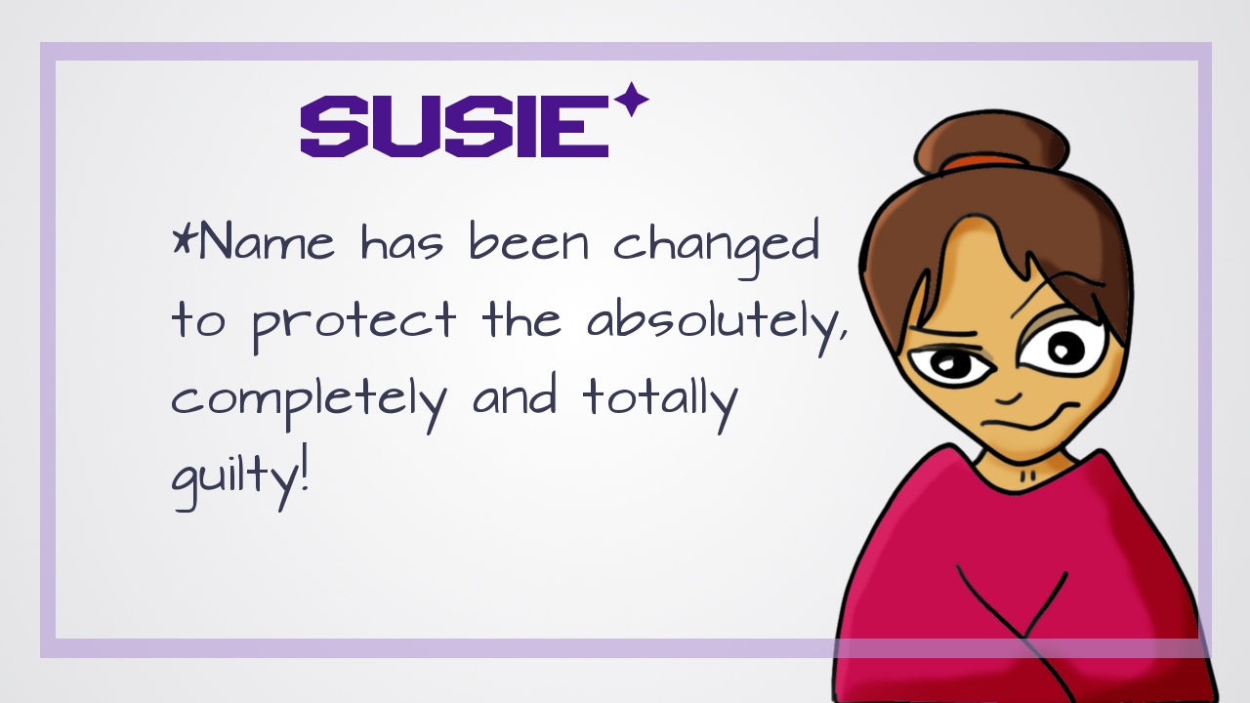

Slide 3
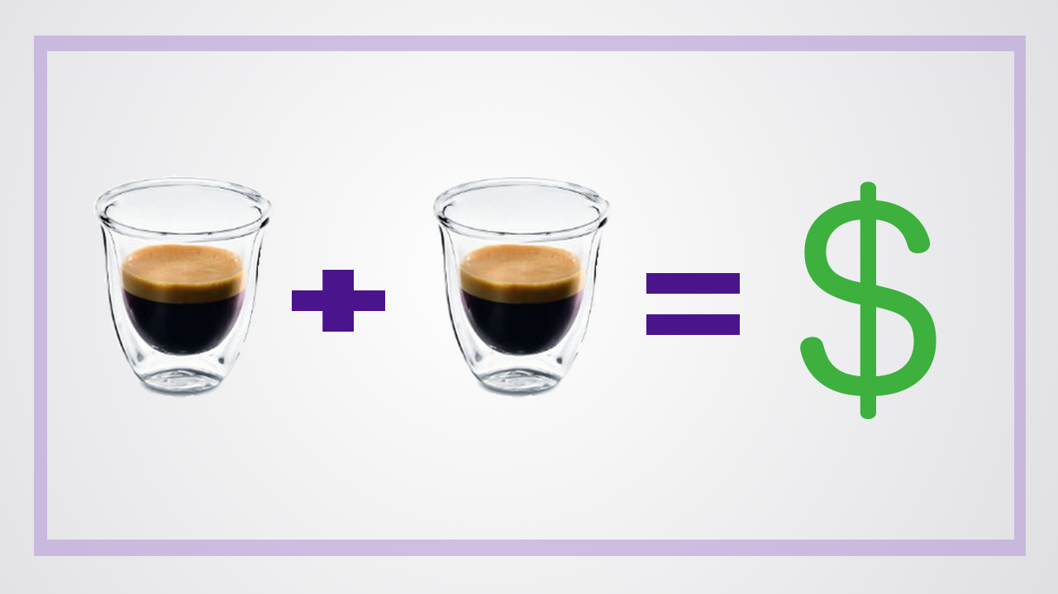

Slide 4
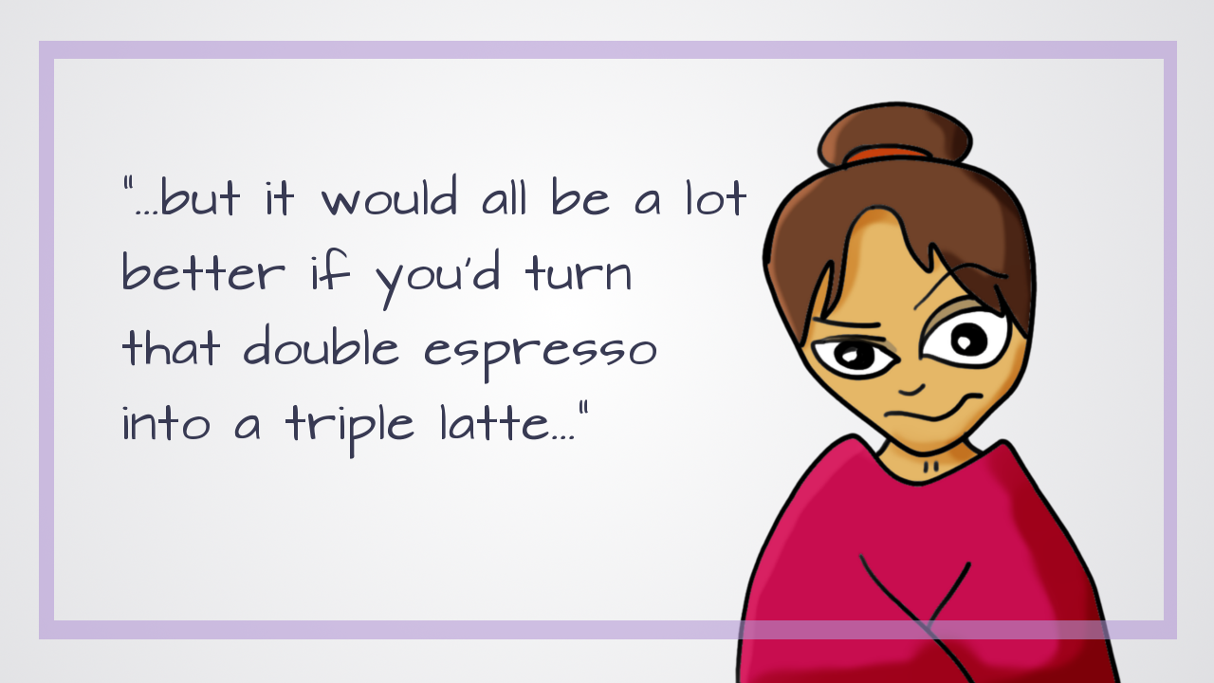

Slide 6
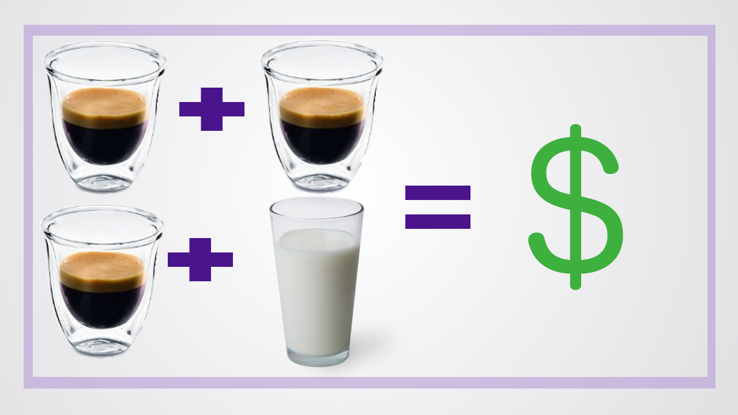

Slide 7
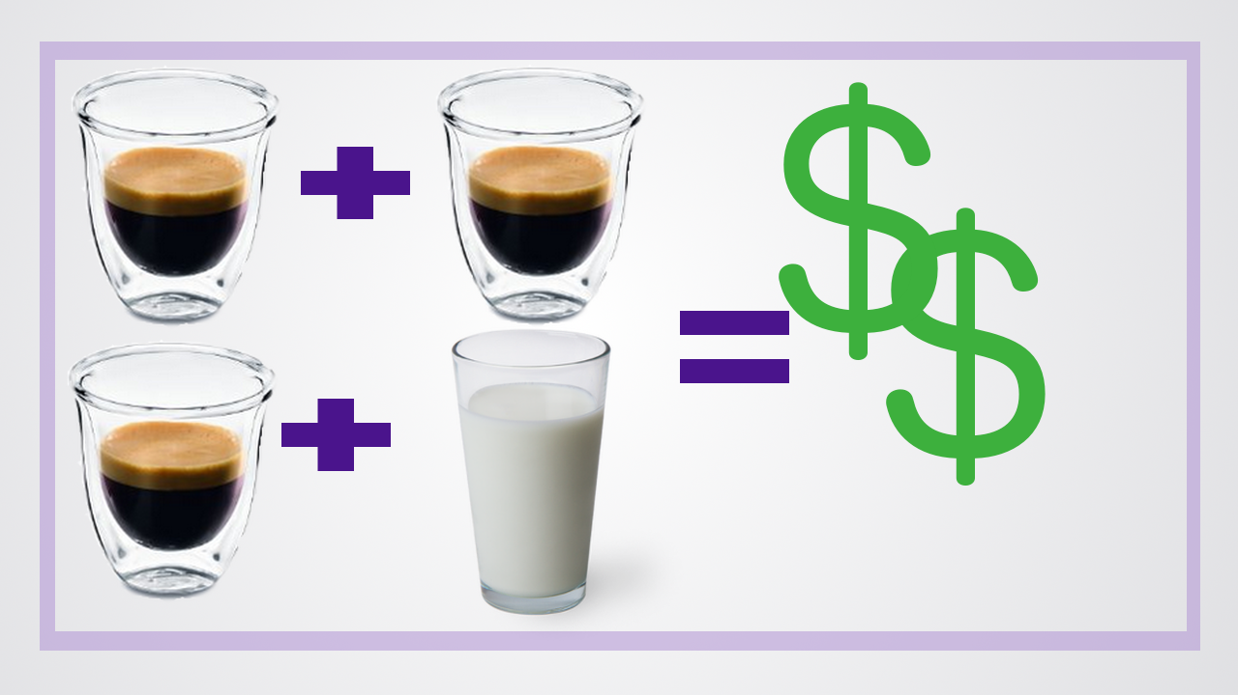

Slide 8
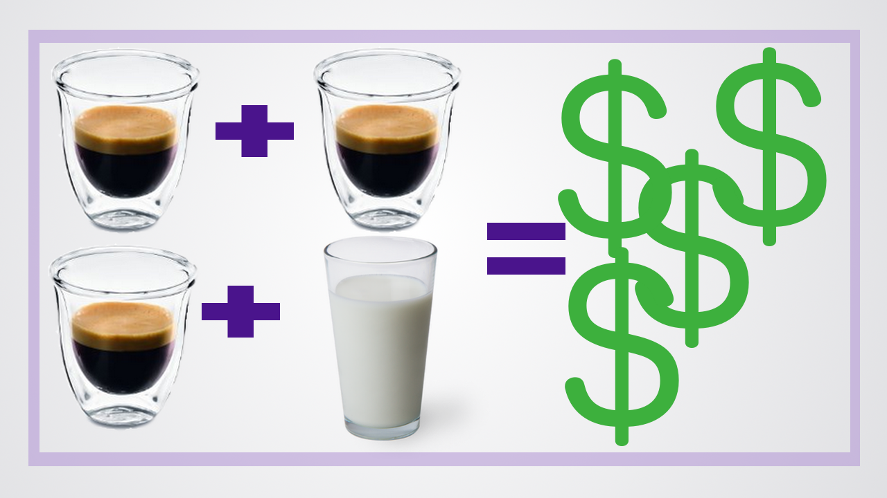

Slide 9
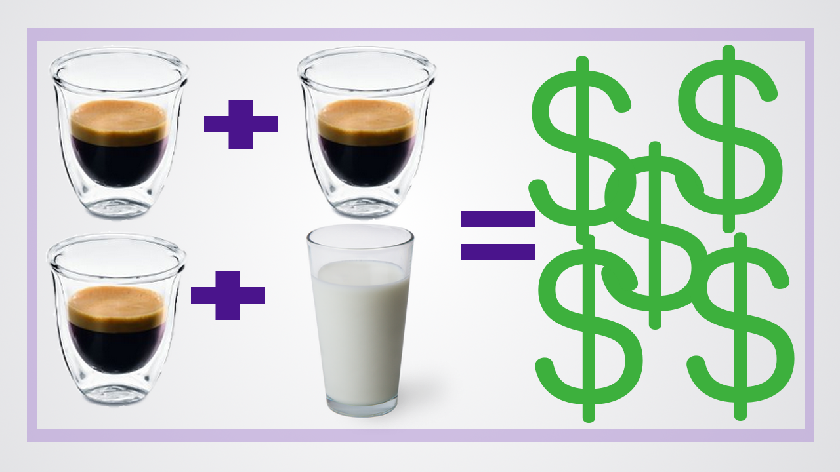

Slide 10


Slide 11
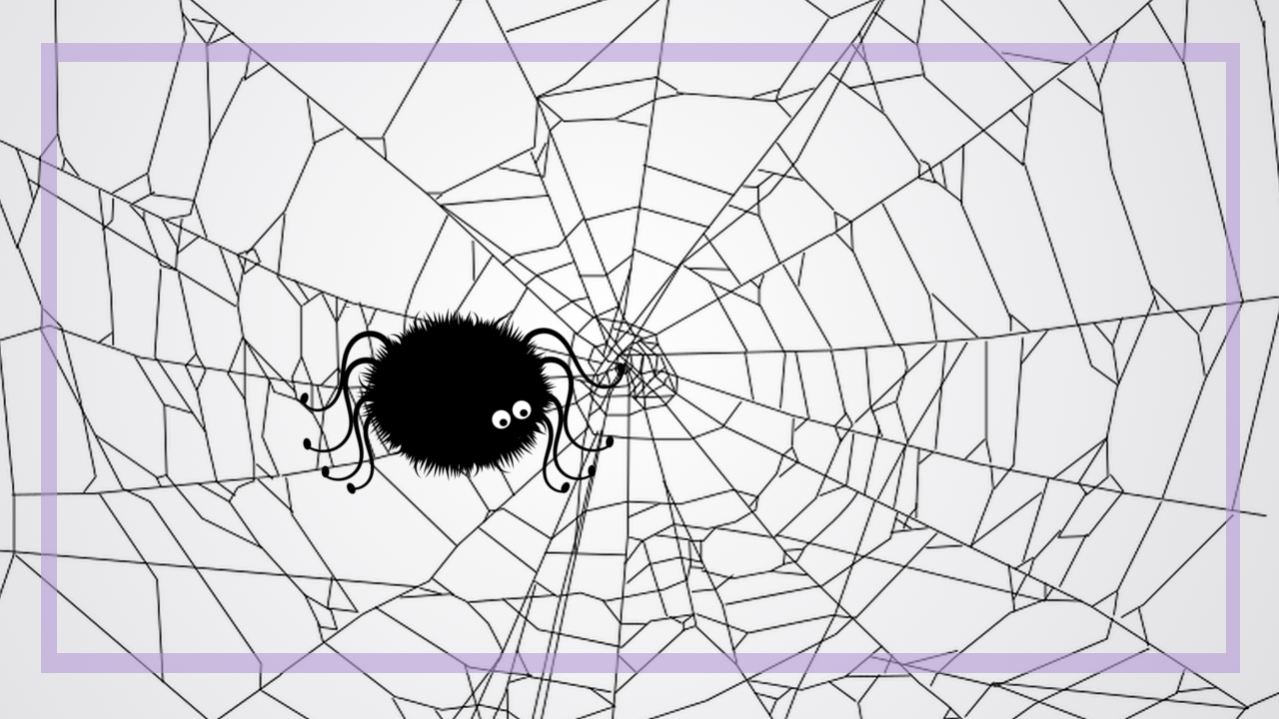

Slide 12


Slide 13
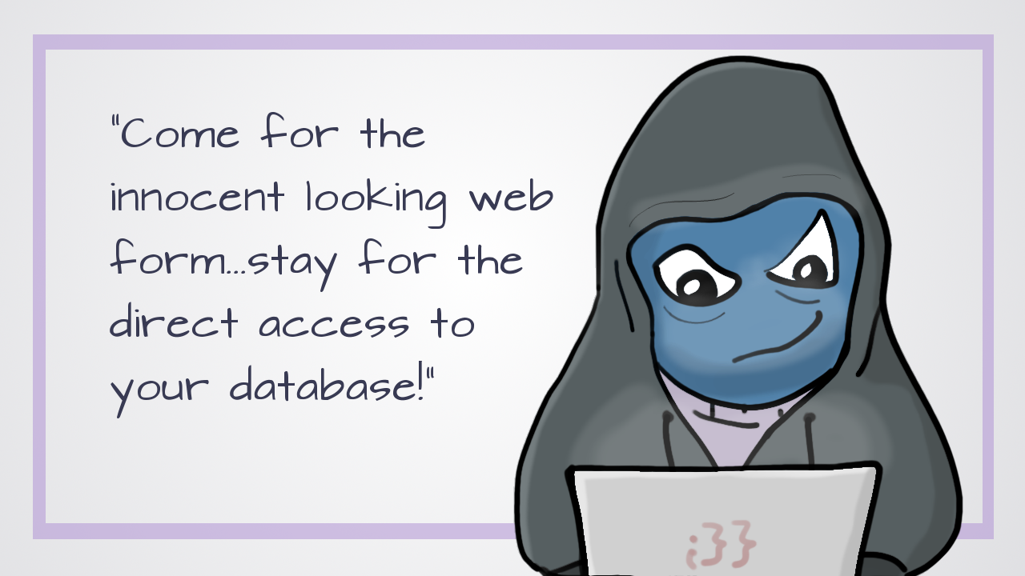

Slide 14
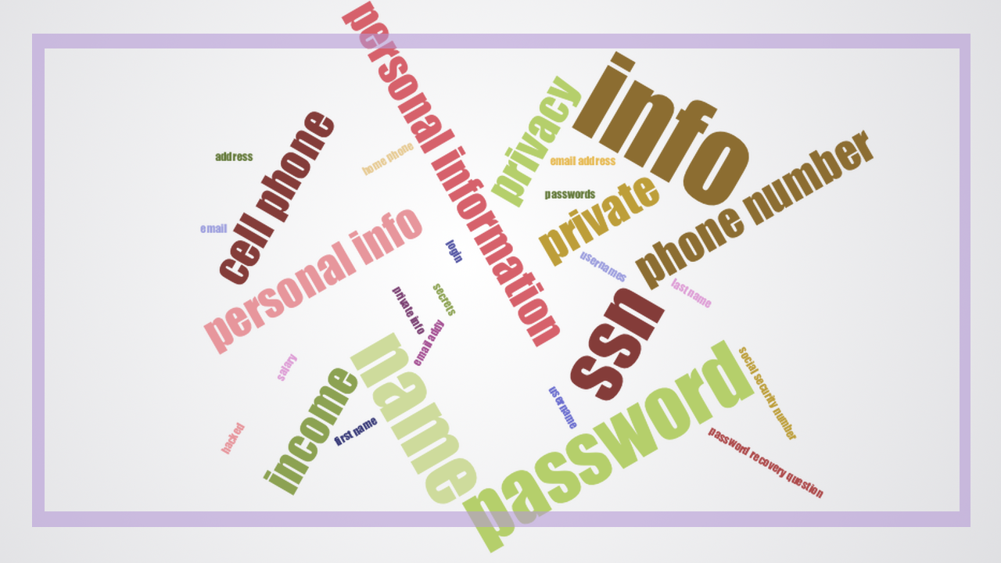

Slide 21


Slide 22


Slide 24


Slide 28


Slide 29

Notes:
I make videos about code at youtube.com/compchomp – if you like code and videos, I’d love to have you check them out.
I’d also love to continue the conversation - I’m on Twitter @JessRudder
And, I’ve “borrowed” the company credit card and we’ll be having drinks in the Hotel lounge before dinner. Come talk diversity and help me spend some of that NY tech money.
Thank you!

